Slide 1
Expanding Access to Palliative Care: Business Plan Essentials
Chicago Regional Leadership Summit for Supportive Care
Chicago, Illinois
May 1, 2015
Tom Gualtieri-Reed, MBA
Spragens & Associates, LLC
Sean O’Mahony, MB, BCh, BAO, MS
Director of the Section of Palliative Medicine at Rush University Medical Center

Slide 2
Agenda
Discuss the essential building blocks for developing a palliative care program
Examine the process for conducting a needs assessment
Discuss variables that will impact staffing, service levels and the business plan
Discuss examples of value measurement
Q&A

Slide 3
Steps to Developing a Palliative Care Program
1
2
3
4
Conduct Needs Assessment
Select the Venue (Hospital, Office, Home, etc.)
Draft a Design for the Program and Test
Develop the Budget and Write the Business Plan
What is the need? Why develop a program?
What type of program is needed? Where?
What services will be offered? What staffing is needed?
What will it cost?
How will we measure value?

Slide 4
Reflections From Experienced Program Leaders
“The single most common problem encountered by palliative care programs that have started outpatient services is that they have started them incrementally and reactively. They want to meet a patient need…They respond with an incremental FTE... Eventually the outpatient needs grow, the difficulty of juggling becomes problematic, and it is hard to get resources to sustain services.”
-From the Center to Advance Palliative Care’s (CAPC) IPAL Needs Assessment introduction
TIP: Take the time to understand the need, prioritize the most critical services and match staffing with service promises.

Slide 5
Planning Your Needs Assessment
Why are you starting or expanding the program? Who has asked you to start or expand the program?
Who and how many could benefit from your program?
Which clinical services are most likely to use or benefit from your services? Oncology? Heart?
Who will likely fund the program?
How are you going to evaluate whether this is the best option for the use of your scarce resources?
What do you need to do next? What additional data or information do you need?
TIP: The Needs Assessment step is an opportunity to build relationships with key internal and external stakeholders.

Slide 6
Table Discussion: Self Discovery - Where Are You Now?
Where are you in your program development? What services do you offer today?
Are you considering starting or expanding your program? If yes, why?
What are your greatest challenges? What data do you need to understand or address those challenges?

Slide 7
Needs Assessment Will Help Determine Venue, Location, and Service Type
Inpatient Consult Service
Outpatient Specialty Clinics
Outpatient PCP Clinics
SNF Consult Service
Provider Home Visits
Inpatient Unit
Cancer Center

Slide 8
Interdependent Variables Impact Program Design
Cancer Center Volume & Mix
Hospital Demographics
Culture
Payer Mix
Program Design
Patient Volume
Service Features
Staffing Plan
MD:APRN Mix
Interdisciplinary Team (Social Worker, Chaplain)
RN Coordinator
Team Norms
Weekend Coverage
Time to Consult
Consult Only and/or Attending Service
24/7 Access
TIP: It is important to match service promises with staffing.

Slide 9
Group Discussion: Case Example Factors That Influence Program Design (…and ultimately performance)
Program Design
Team Composition (e.g. APN)
Organization Culture
Relations with Referring Providers
Staffing Levels
Outpatient Clinic or Hospice Unit
TIP: Trade-offs will be required!

Slide 10
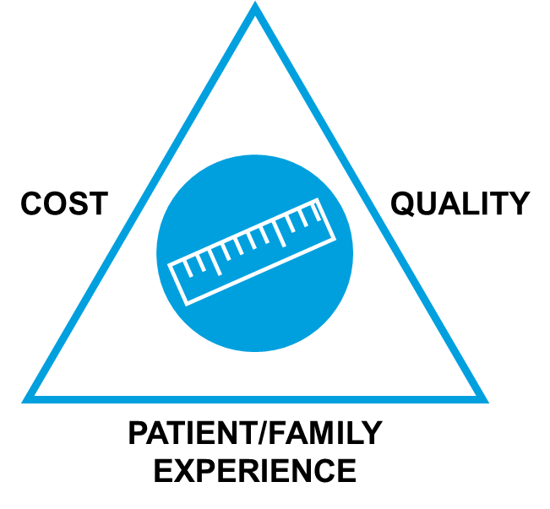
Building the Case: Measuring “Value”
Value can be measured across several dimensions. Value is not necessarily measured in financial terms alone.
TIP: Link value measurement to organizational priorities identified during the Needs Assessment.
Source: www.CAPC.org

Slide 11
Examples of Value
Topic / Outcome | Commentary
Reduced admissions, crisis, ED use | Value depends on type of admission, payment environment, predictability.
Improved status, duration in research study, survival | May increase research effectiveness, future research $, patient participation.
Accessibility / continuity relationships | May promote patient loyalty, reduce resource use, and help with market share.
Better use of ICU beds | Improved capacity (for new patients).
Reduced inpatient mortality | Rankings may matter.
Others…

Slide 12
Interdependent Variables Also Impact the Budget
Patient Volume
Cancer center patient volume & mix
Billing Revenue
Volume: new & follow-up
Workload Costs
Staffing to volume
Savings
Volume
Staffing level & mix
Effectiveness
Staff mix
Collections / effectiveness
Documentation
Patient need, MD culture
Mix (salary)
Other norms
Patient mix & locale
Effectiveness / mix of service
Cost accounting norms
Follow–up capacity
Speed to action
Coverage (weekends?)
Value propositions
Payer mix

Slide 13
Business Plan Outline
Pulling it all together.
Needs Assessment
Problem & Opportunity
Program Design
What You Propose to Do
Value Measurement & Budget
Financial Costs & Benefits
TIP: Your organization may have its own format and requirements. Check with your administrative sponsor or finance department.

Slide 14
Q&A

