Slide 1
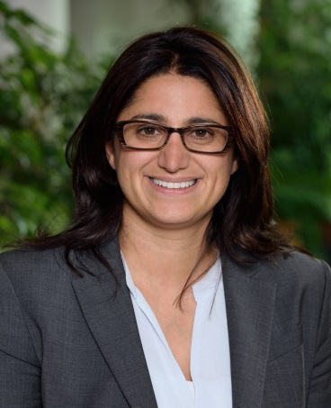
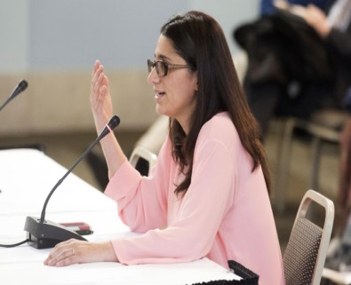
Flint Water Crisis: Background and Next Steps
Mona Hanna-Attisha, MD, MPH
Tuesday August 30, 2016 at 12-1pm
Billings Auditorium, P-117
Everyone welcome!
This symposium is sponsored by Leadership for Urban Primary Care Education and Transformation (LUCENT).
Mona Hanna-Attisha MD MPH FAAP is director of Hurley Children's Hospital’s Pediatric Residency Program and Assistant Professor of Pediatrics and Human Development at Michigan State University's College of Human Medicine in Flint, Michigan. With a background in environmental health, Dr. Hanna-Attisha completed medical school at Michigan State University, residency and chief residency at Children’s Hospital of Michigan, and public health training in health policy from the University of Michigan. In addition to educating the next generation of physicians, Dr. Hanna-Attisha now directs the Michigan State University and Hurley Children's Hospital Pediatric Public Health Initiative, an innovative and model public health program to research, monitor and mitigate the impact of the Flint water lead crisis.
For information about the LUCENT program, visit us at www.lucent.uchicago.edu. Contact us at lucent@bsd.uchicago.edu or
773-834-2688

